Slide 1
Efficient In-Database Patient Similarity Analysis for Personalized Medical Decision Support Systems

Slide 2
This lesson is specialy issue for Medical Data Analytics…

Slide 3
Patient similarity analysis is a precondition to apply machine learning technology on medical data.
patient similarity analysis harnesses the information wealth of electronic medical records (EMRs)
The Current implementations for patient similarity analysis require their users to have knowledge of complex data analysis tools

Slide 4
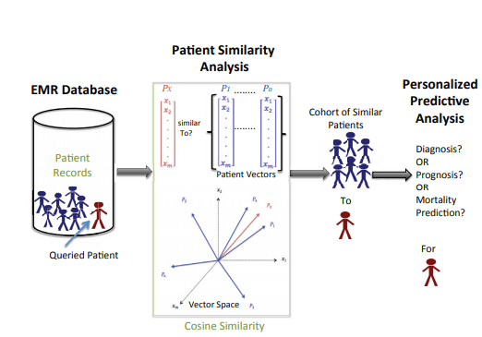

Slide 5
Hear 2 similarity calculations is required
Analyzing patient similarity leads to data explosion
2. Current patient similarity analysis require their users to have knowledge of complex data analysis tools

Slide 6
The patient similarity analytics

Slide 7
Researchers have done a lot of advanced work in the field of patient similarity analysis. However, we tried a new in-database approach for implementation and analyzed options for performance….!
Different Evaluation Base
A new Approach to Implement Patient Similarity Analysis
Evaluating Column-oriented and Row-oriented Databases
Optimizing Patient Similarity Calculation

Slide 8
Optimizing Patient Similarity Calculation:
In all of the above mentioned research slides the patient similarity analysis is used as a basis for developing a prediction model……

Slide 9
Data Analysis tools: Data analytic platforms and tools such as Hadoop, Mahout or R are 19 one approach to implement patient similarity analysis. In order to assess their performance, as an alternative to our in-database approach, we used Apache Mahout to implement patient similarity analysis (that is, cosine similarity)

Slide 10
Database Management Systems:
implementing patient similarity analysis is to use a DBMS. Either relational DBMSs or NoSQL databases are a valid choice
– NoSQL Databases: NoSQL
Relational Databases: I

Slide 11
Conclusion
The use of DBMS for data medical analysis brings many advantages. Our most significant result is that we showed the capability of implementating patient similarity analysis inside a relational database system

Slide 12
Thank you….

